Slide 1

RISK AND RESILIENCE BOOTCAMP
8

Slide 2


Slide 3

controls
This section is an introduction to controls
Preventive Controls
Detective Controls
Corrective Controls

Slide 4
Preventive Controls
Preventive controls
Proactive risk and resiliency management
Measures put in place before an incident occurs
Designed to stop or reduce the likelihood that a risk event occurs or to inhibit its progress
The goal is to prevent undesirable events from happening
In ISACA terms
Preventive controls are part of “control activities”
Safeguards to maintain integrity, availability and confidentiality
In risk vocabulary, they reduce inherent risk by influencing likelihood of events occurring
In DRI / resilience thinking
Preventive controls are the “absorb” or “anticipate” buffer for the impact of events
They help avoid or reduce the shock before it becomes a disruption

Slide 5
Preventive controls
Perform risk assessment and threat modeling
Identify key risk scenarios, threat types, and vulnerabilities
Estimate likelihood, impact, and residual risk
Prioritize by risk appetite and cost-benefit
Use cost, complexity, expected reduction in risk, and residual risk to rank candidate controls
Choose controls whose cost is justified by risk reduction
Consider control layering and defence in depth
Don’t rely on a single control
Use overlapping layers
For example: combine network controls, authentication, and process controls

Slide 6
Preventive Controls
Ensure feasibility and compatibility
The control must integrate with existing architecture without undue fragility
Consider performance, usability, maintainability
Map to frameworks and standards
ISACA governance framework
COBIT/COBIT-derived frameworks
Align control objectives to domain goals

Slide 7
Preventive Controls
Define control requirements and specifications
What must the control accomplish?
For example: block unauthorized access, enforce encryption
Determine metrics, thresholds, SLAs, exception handling, and review cycles
Document in a control catalog or risk-control matrix
Map risks to controls, mark preventive / detective / corrective
Tracks ownership & testing
ISACA often expects controls to be documented, tested, and periodically reviewed

Slide 8
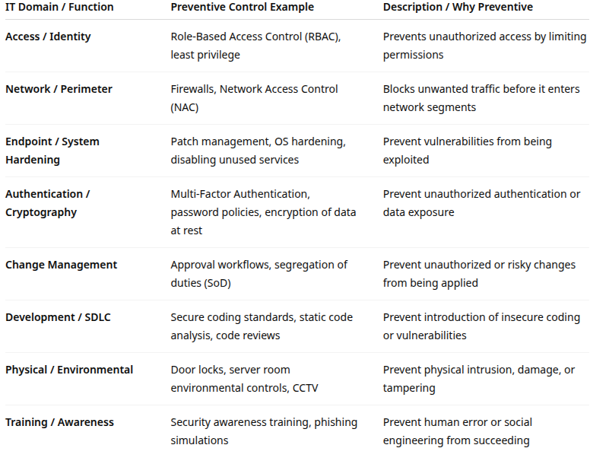
Preventive Controls

Slide 9
Detective Controls
Detective control
Mechanisms designed to identify, detect, or alert when an adverse event or anomaly occurs
Backup if preventive controls fail or something unexpected happens
Their goal is to provide visibility, raise alarms, and feed information to response functions
Validate via data collection that preventative controls are working
In ISACA and assurance practice
Detective controls allow validation that preventive controls are functioning
Detective controls are also designed to respond to exceptions or anomalies
In resilience terms
Detective controls contribute to the “sensing” or “detect and respond” capabilities
They are often triggers for compensatory responses

Slide 10
Detective Controls
Identify key indicators, signals and events
Determine which system events, logs, patterns, or deviations are meaningful
Define thresholds, anomaly detection, correlation logic
Ensure coverage across layers
Not only network or host, but also application, database, user behavior, business processes
Balance sensitivity, noise and false positives
Tune thresholds to avoid “alert fatigue”
Use correlation, context, and filters to reduce irrelevant alerts

Slide 11
Detective Controls
Ensure timeliness
Detect quickly enough that corrective action can beat escalation
Define SLAs or time thresholds for detection
Link to response processes
Alerts should feed to incident response plans, escalation paths, dashboards
The outputs of detective controls must be actionable
Log and auditability
Maintain secure, tamper-evident logs or event capture
Ensure logs are retained for forensic analysis

Slide 12
Detective Controls
Periodic review, tuning and testing
Regularly test detection rules and simulate attacks (red teaming, logging exercises)
Evaluate gaps or blind spots
In ISACA or audit frameworks
Detective controls often are tested during assurance engagements to validate control effectiveness

Slide 13
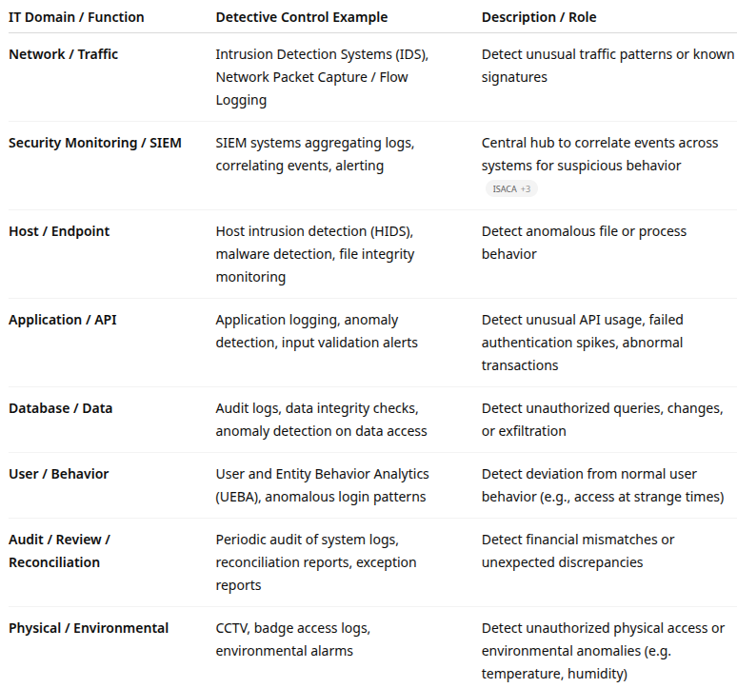
Detective Controls

Slide 14
Corrective Controls
Corrective controls
Restoration, damage control, prevent recurrence
Are put in place after a detected event
Intended to restore systems, mitigate damage, contain ongoing issues
Designed to prevent recurrence of the same or similar event
Respond to the incident, remediate, and improve controls to avoid repeat incidents
In resilience DRI resilience context
Corrective controls often combine containment, recovery, restoration, and learning
In ISACA assurance
Corrective controls are part of incident response, business continuity and disaster recovery processes, patching, and root cause remediation

Slide 15
Corrective Controls
Incident response and root cause analysis
Once a control failure or security event is detected, perform root cause analysis
Identify what went wrong
For example: control failure, process gap, misconfiguration, human error
Define remediation steps and plan
What must be done to contain, isolate, remove, or patch the threat
Define roles, timelines, rollback plans, dependencies
Ensure rapid recovery and restoration
Use backups, redundancy, failover, or alternate systems
Prioritize restoring critical services first

Slide 16
Corrective Controls
Implement preventive enhancements
After recovery, modify preventive and detection controls so that the same event doesn’t recur
Use it as a “lesson learned” to improve preventative controls
Test and validate the remediation
After corrective changes, test to ensure they work and don’t break other systems
Update policies, procedures and training
Update documentation, checklists, standard operating procedures, and train staff
Ensure that human processes incorporate the new lessons
Monitoring and audit of the corrected state
Monitor over time to detect if the fix holds, or if regressions occur
Periodic reviews and audits

Slide 17
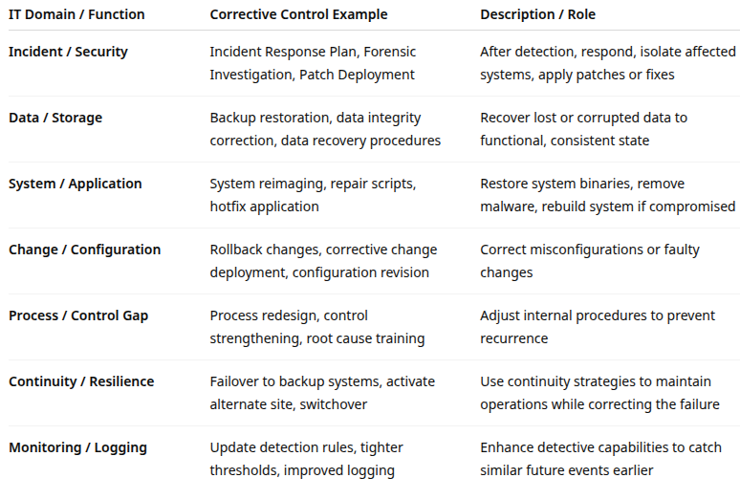
Corrective Controls

Slide 18
example
A web application vulnerability is exploited
The corrective control steps might be
Quarantine or take the web server offline (containment)
Restore from clean backup or re-deploy the patch (restoration)
Apply patch or upgrade the vulnerable module
Conduct root cause analysis to see why the patch was not applied earlier
Update patch management procedures and strengthen monitoring so similar exploit attempts are caught earlier
Validate the patch works and monitor logs to confirm no re-infection

Slide 19
example
A mis-configuration causes downtime
The corrective control steps might be
Rollback to the last known good configuration
Fix the misconfiguration script
Add automated pre-deployment checks
Retest

Slide 20
Integration & Control Design
ISACA assurance controls
Controls are evaluated for design effectiveness and operating effectiveness
Auditors will map
Requirements (laws, policies, standards) to control objectives then to specific controls
Control framework or control catalog
Includes control types (preventive, detective, corrective)
Ownership, testing frequency, and metrics
Assurance engagements
Test that preventive controls are in place
Test that detective controls detect failure
That corrective controls properly restore and prevent recurrence

Slide 21
Integration & Control Design
DRI, resilience and continuity perspective
Controls are integral to resilience strategies
Preventive controls reduce disruption frequency
Detective controls enable quick detection and response
Corrective controls enable recovery and adaptation
In business continuity and disaster recovery planning
Often see corrective controls and recovery strategies merging (DR plans, backup, alternate site)
The DRI community emphasizes
Lessons learned, post-incident review, and improvement
Feedback loops from corrective to preventive

Slide 22
Standard Forms - Templates
Often used in ISACA or enterprise risk management settings:
Risk-control matrix or control mapping matrix
Maps risks to controls, control types (prevent/detect/correct), control owner, control frequency, test procedures
Control catalog
Repository of defined controls with descriptions, type classifications, performance criteria
Test plans and control test scripts
Implemented for each control
How a control will be tested for design and operating effectiveness
Root cause template
Captures event, detection, corrective actions, lessons learned, preventive enhancements
Change request templates
Include required control impact analysis
Control self-assessment (CSA) forms
For control owners to self-certify control status, exceptions, and remediation

Slide 23
Process Maturity and Controls
Controls are only as strong as the processes that define, apply, and monitor them
Maturity directly affects control design, consistency, effectiveness, and adaptability
. Control design quality
In immature organizations, controls are reactive, informal, or not properly aligned to risks
Mature organizations design controls based on risk analysis, data, and policy frameworks, leading to more precise preventive, detective, and corrective mechanisms
Control execution and consistency
Immature processes depend on people’s discretion (“tribal knowledge”)
Mature processes embed controls in standardized workflows, automated pipelines, and governance tools: ensuring consistency and repeatability

Slide 24
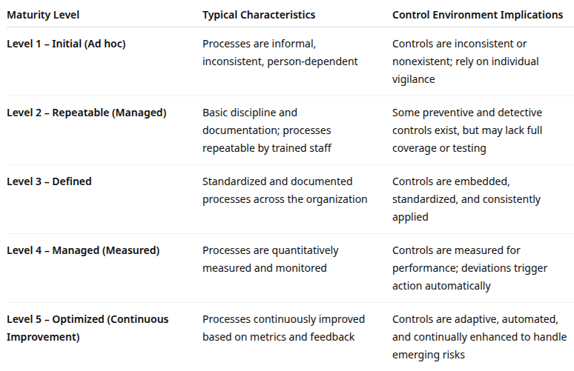
Process maturity

Slide 25
Process Maturity and Controls
Monitoring and measurement
Low-maturity organizations rarely test control effectiveness; failures go unnoticed
At higher maturity, control performance is monitored with defined KPIs/KRIs (e.g., number of incidents detected, MTTR, patch cycle compliance)
This feedback allows continual refinement: necessary for resilience
Adaptability and resilience
Immature controls struggle to adapt to new risks (e.g., emerging cyber threats, regulatory changes)
Mature controls are part of a living system: continuously assessed and improved via post-incident reviews, audits, and lessons learned.

Slide 26
Process Maturity and Controls
Integration across functions
Early maturity: siloed departments, fragmented control ownership
High maturity: integrated governance (e.g., GRC systems, shared risk registers) where controls align with strategic, operational, and compliance goals

Slide 27
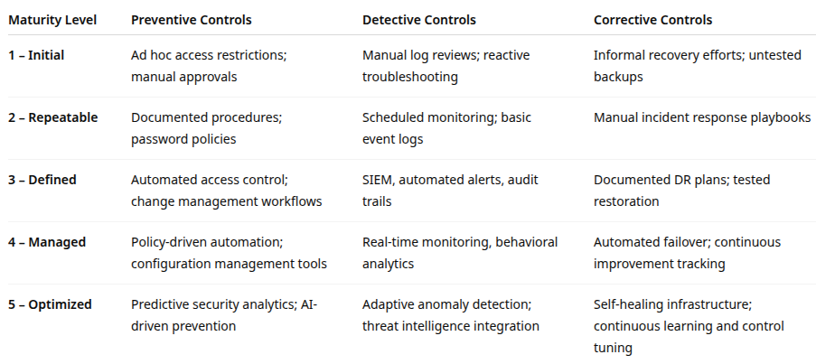
Process Maturity and Controls

Slide 28
Process Maturity and Controls
From a risk management perspective
Higher process maturity reduces control risk, which is the risk that controls will fail to prevent or detect issues
Mature organizations can more accurately predict, prevent, and recover from disruptions
From a resilience management (DRI/CERT-RMM) perspective
Mature processes foster operational resilience expressed as the ability to maintain critical functions under stress
Resilience maturity grows in tandem with control maturity

Slide 29
Assess and improve maturity
Perform a control maturity assessment
Use frameworks like COBIT 2019’s Process Capability Model or CERT-RMM
Evaluate for each process: definition, documentation, measurement, and continuous improvement
Identify control weaknesses or gaps
Compare current controls to framework expectations or regulatory standards
Determine if gaps arise from low maturity (e.g., no ownership, no automation, poor testing)
Prioritize improvements
Focus first on processes with the highest risk exposure and lowest maturity
Institutionalize continuous improvement
Build post-incident reviews, audits, and self-assessments into governance cycles
Create feedback loops that automatically refine controls over time

Slide 30

Q&A and open discussion
Notes:
Now is the time to engage in an interactive Q&A session where you can ask questions, share insights, and clarify any doubts about the topics we have covered so far.
This open discussion is designed to ensure that every participant has the opportunity to voice their thoughts and learn from the collective experience of the group.
Your questions and comments are valuable as they help us identify areas that may need further explanation and enable us to tailor future sessions to your needs.
We encourage you to speak up and contribute to the dialogue, as this interaction is one of the key components of our interactive learning approach.
As the session progresses, take note of any questions or ideas that you would like to revisit, and feel free to share your perspectives with the class.

